Slide 1

Destination New England! What new Students are coming to!
Top Colleges including few IVY Leagues, Great sports teams, friendly environment and what more?
Youssou Fall
March 2019
Notes:
To change the image on this slide, select the picture and delete it. Then click the Pictures icon in the placeholder to insert your own image.

Slide 2
1. Introduction/Business Problem
1.1. Problem definition:
Every year thousands of new students call New England their home for the next 4 years. Finding a new place to live for the many who opt to leave off campus, could be a bit tricky if you only rely on few web search here and there, not to mention such process is time consuming and can be costly if you land at the wrong neighborhoods. This project is alleviate the hard tasks and eliminate the guessing game for the thousand of students and families different city, state, and/or country moving to New England this Fall. I will cover all of New England city and town area (NECTA). NECTA is a geographic and statistical entity defined by the U.S. federal government for use in the six-state New England region of the United States. NECTAs are analogous to metropolitan statistical areas and metropolitan statistical areas and are defined using the same criteria, except that they are defined on the basis of New England towns instead of entire counties. NECTAs are classified as either metropolitan or metropolitan NECTAs. A metropolitan NECTA has an urban core with a population of at least 10,000 but less than 50,000, whereas a metropolitan NECTA has an urban core with a population of at least 50,000.

Slide 3
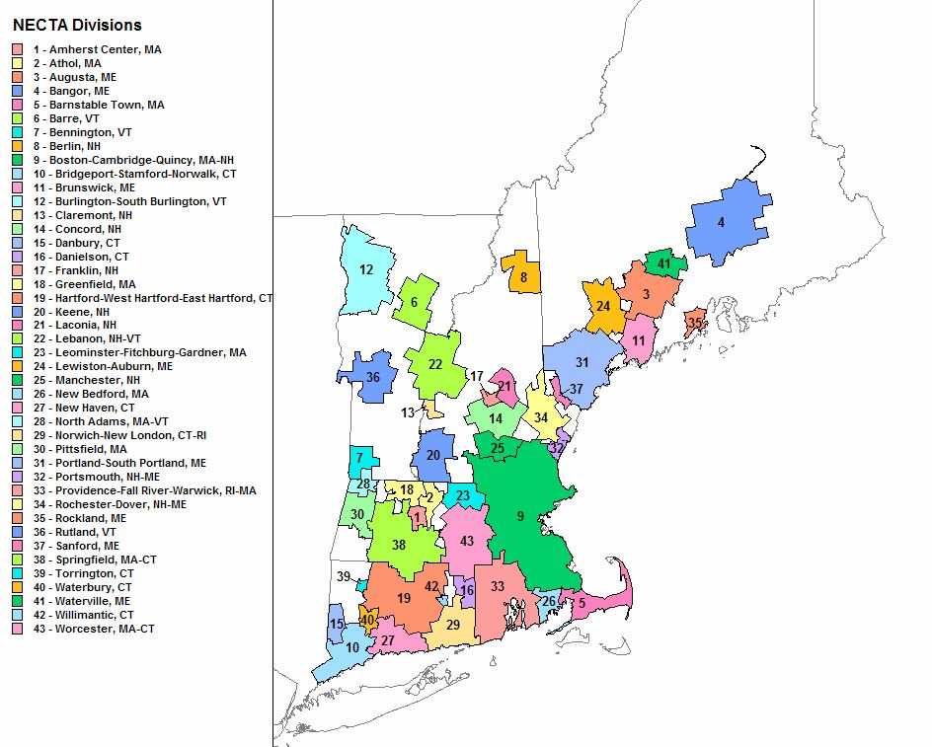
Let’s explore the New England city and town area (NECTA)

Slide 4
1. Introduction/Business Problem
1.2. Targeted audience: I propose a way of shortening the new students' search process by using data about the most popular venues of each area to help find their "venue profile". Potentially there are few groups of people interested in this type of insights:
The some real estate companies knowing what are the requirements – venue profile of the client, this analysis will limit the search area to the preferred venues of clients, and therefore the need of real estate resources and time.
The New students who want to move or relocate to this NECTA. This type of analysis can speed up the process of searching a place to live saving time and money. It will also help investors who see an opportunity to invest in apartments.
1.3. Search requirements: Students are known to consume lot of Pizza, they love coffee shops, bugger joins and restaurants, gyms to name a few. Therefore my highlights will be focused on:
Coffee shop
Book store
Restaurants
Theater
Pizza
Parks

Slide 5
2. Data to support this project
2. Data to support this project
2.1. Data description
To capture the "venue profiles" of the NECTAs, I use:
- Web scraping with BeautifulSoup to obtain a list of New England city and town area (NECTA).
The Wiki page: https://en.wikipedia.org/wiki/New_England_city_and_town_area has a table with:
List of all the NECTA,
2010 Population,
2000 Population,
Percent change,

Slide 6
2. Data to support this project
- Nomination from geopy.geocoders for geocoding the County names and get their coordinates.
With Nomination we will be able to concatenate the list of New England city and town area (NECTA) with their coordinates.
- Foursquare API to get all venues in the
With Foursquare we will get the top venues that are within certain radius of each other.
Rank | NECTA | State(s) | 2000 Pop | 2010 Pop | %Change
1 | Boston–Cambridge–Quincy | MA-NH | 4,503,683 | 4,703,187 | 4.43%
2 | Providence–Fall River–Warwick | RI-MA | 1,292,942 | 1,301,595 | 0.67%
3 | Hartford–West Hartford–East Hartford | CT | 1,059,878 | 1,121,463 | 5.81%
4 | Bridgeport–Stamford–Norwalk | CT | 892,283 | 926,465 | 3.83%
5 | Springfield | MA-CT | 660,837 | 683,800 | 3.47%
6 | New Haven | CT | 571,310 | 597,172 | 4.53%
7 | Worcester | MA-CT | 539,828 | 577,537 | 6.99%
8 | Portland–South Portland–Biddeford | ME | 333,624 | 357,412 | 7.13%
9 | Norwich–New London | CT-RI | 265,288 | 278,598 | 5.02%
10 | Barnstable Town | MA | 244,257 | 239,675 | -1.88%
11 | Waterbury | CT | 195,540 | 204,451 | 4.56%
12 | Burlington–South Burlington | VT | 187,105 | 198,627 | 6.16%
13 | Manchester | NH | 176,663 | 187,596 | 6.19%
14 | New Bedford | MA | 170,161 | 175,502 | 3.14%
15 | Danbury | CT | 155,304 | 163,260 | 5.12%
16 | Rochester–Dover | NH-ME | 135,367 | 149,471 | 10.42%
17 | Leominster–Fitchburg–Gardner | MA | 143,905 | 147,818 | 2.72%
18 | Bangor | ME | 124,906 | 135,632 | 8.59%
19 | Lewiston–Auburn | ME | 101,778 | 106,216 | 4.36%
20 | Portsmouth | NH-ME | 71,232 | 73,274 | 2.87%
21 | Pittsfield | MA | 73,297 | 72,051 | -1.70%

Slide 7
3. Methodology
The methods used in this work were:
Web Scraping with the BeautifulSoup library
Geocoding with Nominalism from geopy.geocoders
Data acquisition from Foursquare's API
Feature reduction by considering most common venue categories
Machine learning: k-Means clustering because it is the most simple clustering algorithm and it was capable of meeting the proposed objective

Slide 8
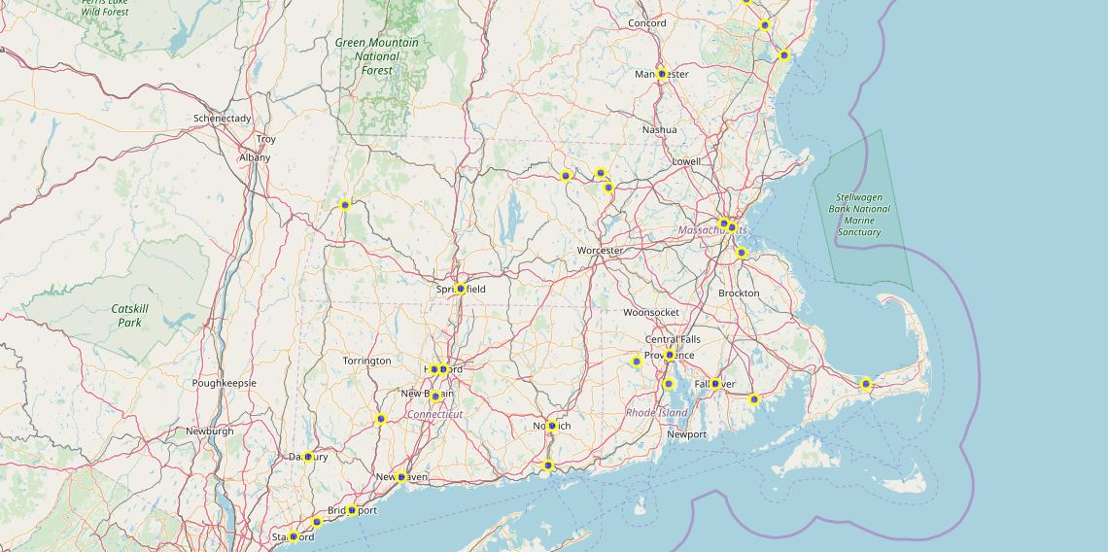
4. Results
4.1. Web scraping
This is the Wikipedia page https://en.wikipedia.org/wiki/New_England_city_and_town_area that contains a list of all towns in New England.

Slide 9
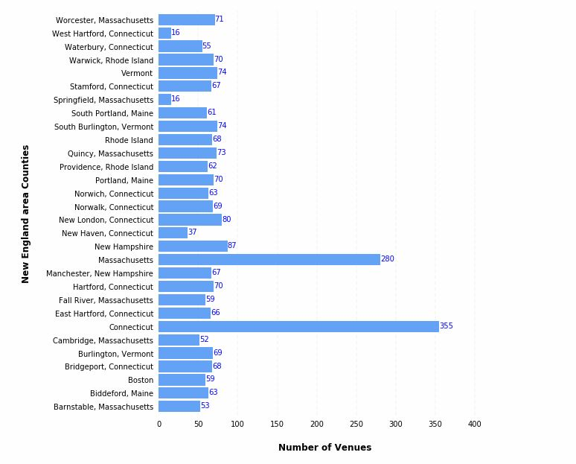
4. Results
4.2. Mapping the NECTAs with clusters.
The goal is This project is alleviate the hard tasks and eliminate the guessing game for the thousands of students and families different city, state, and/or country moving to New England this Fall, to do that I will cluster based on the NECTAs.
First I evaluate the venues by NECTAs

Slide 10
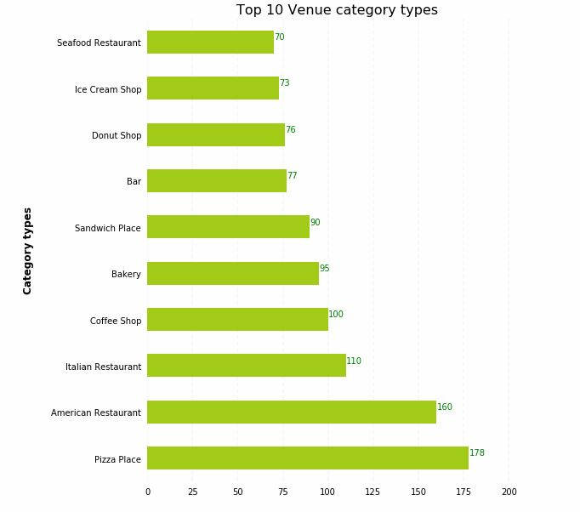
4. Results
Second look at the top venues

Slide 11
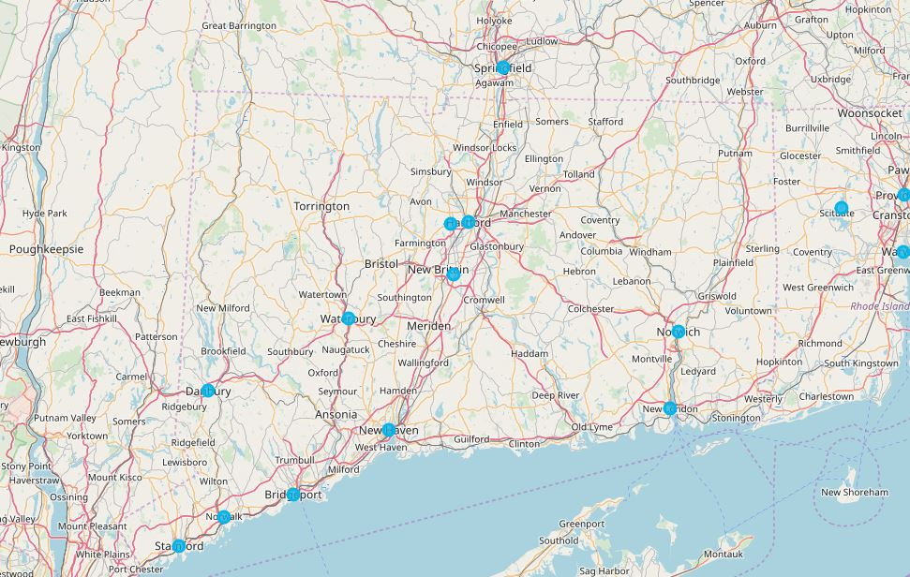
4. Results
Clustered NECTAs

Slide 12
4. Results
Venues strengths on top NECTAs

Slide 13
5. Discussion
The objective of this analysis was to shorten the search process of finding a place to live in New England by analyzing the most popular "venue profiles" for clusters of counties
The ten most common venue categories of each cluster that we identified are enough to reveal differences between them and allow students to imagine which "client profile" fits best based on venues like:
Coffee shop
Book store
Restaurants
Theater
Pizza
Parks
Cluster venues and matches based on the venues above.
1. Cluster 0 - Has about 17% of the desired venues above
2. Cluster 1 - Has about 7% of the desired venues above
3. Cluster 2 - Has about 13% of the desired venues above
4. Cluster 3 - Has about 7% of the desired venues above
5. Cluster 4 - Has about 10% of the desired venues above
6. Cluster 5 - Has about 3% of the desired venues above
7. Cluster 6 - Has about 33% of the desired venues above
8. Cluster 7 - Has about 7% of the desired venues above
9. Cluster 8 - Has about 3% of the desired venues above
Cluster 6 is the strongest with about 33% of the prime venues

Slide 14
6. Conclusion
The analysis showed here, albeit simple, successfully identified 9 clusters of counties in New England with different venues profiles that can be mapped to different students wishes.
The cluster that best matches our targeted "venue requirements" is cluster 6 with 33%. we can set new desirable venues and cluster based on them.
Many enhancements to this analysis can be done to help students pick an ideal area to live:
How close is the NECTA to the college
What are the types of public transportation exist between the NECTAs
College ranking and locations and admission rate.

